Slide 1

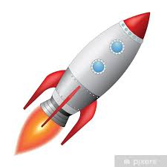
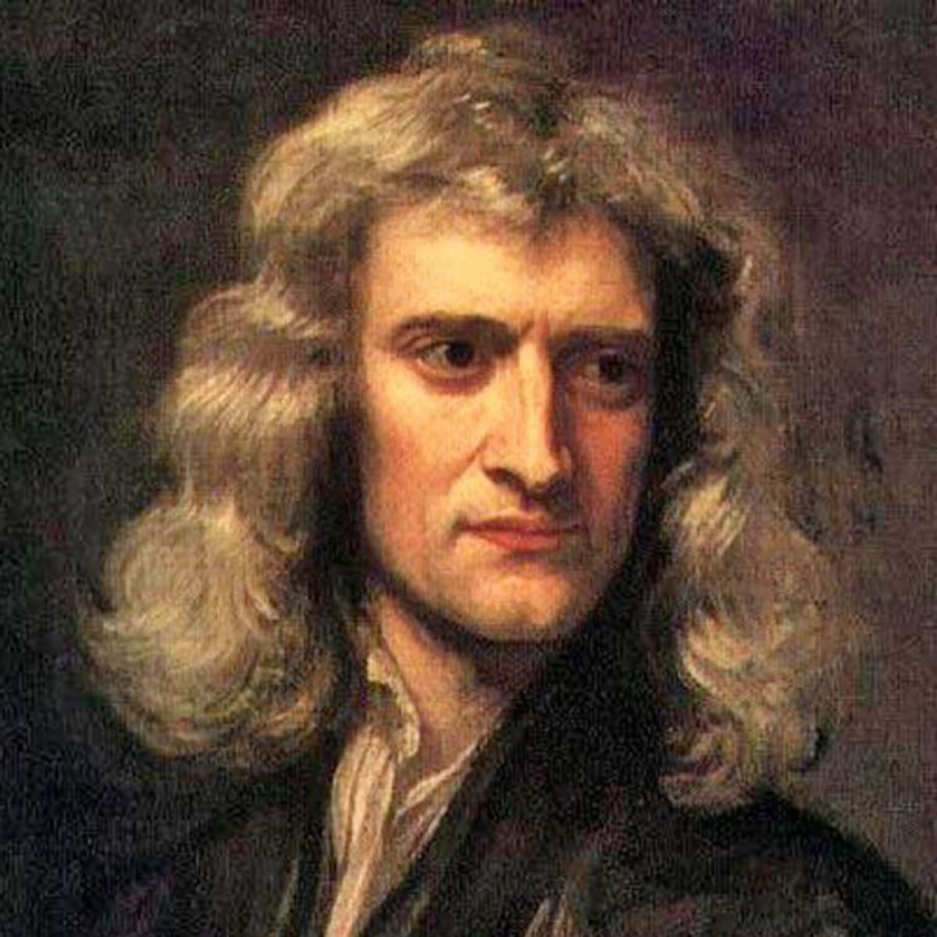
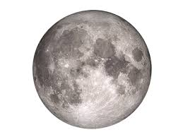
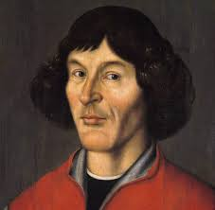
解密神奇的宇宙 Unlocking the secrets of the Universe
Session 1: to the Moon and back with Newton
Hello Universe!
Today’s VIP guest list
The Universe is full of surprises and paradoxes, unresolved mysteries and unproven theories. In this course, we will delve into these and try to understand how humans fit into the big, big Universe, and how we can exploit the laws governing the Universe to go to the Moon, travel to other planets such as Mars, and one day perhaps establish colonies in other stellar systems and other galaxies.
But first, let’s start with the basics. In this session, we will introduce the key scales of the Universe to give you an idea of how big (and small), how hot (and cold) and how fast (and slow) the Universe is. We will also see how simple rules of classical mechanics can be used to go to the Moon and learn about the Rocket Equation that you can use to build your own spaceship that will take you to the Moon and other places in far away space. (don’t do this at home!)
Isaac Newton
Session objectives
Understand how big (and small), how hot (and cold) and how fast (and slow) the Universe is
Recap classical mechanics and the key conservation laws
Introduce the concept of scientific revolution
Use Newtonian mechanics to derive the escape velocity from Earth to space
Derive, understand and apply the Rocket Equation to design a simple spaceship
Key terms
classical mechanics
经典力学
Scientific Revolution
科学革命
escape velocity
逃逸速度
conservation Laws
守恒律
(scientific) paradigm
（科学）范式
Rocket Equation
火箭公式

Slide 2

解密神奇的宇宙 Unlocking the Secrets of the Universe
Classical mechanics
经典力学
Area of physics dealing with description of motion of macroscopic (big) objects, such as space rockets, cars or billiard balls.
Quantum mechanics
量子力学
Area of physics dealing with description of behavior of very, very small things (atoms, particles, etc.)
Paradigm
典范
An idea, concept or rule that most people assume to be true. For example, the theory of evolution via natural selection is a (proven) scientific paradigm that most people around the world accept as true.
When a major paradigm is changed or proven to be wrong, this is when a “scientific revolution” happens.
Scientific revolution
科学革命
A time when due to e.g. new evidence, new experiments, new proofs etc. a major paradigm in science is proven to be wrong. For example, Aristotelean mechanics was overturned （颠覆）by Newton’s mechanics.
1
Classical Mechanics
The laws of classical mechanics were discovered and described by Isaac Newton (and others around the same time) in 17th-18th c.
Classical mechanics describes the motion of macroscopic (big) objects. These could be as small as ping-pong balls, or as big as spaceships.
Classical mechanics is very successful in describing motion of objects in our world. The same laws apply to the football kicked during a football match, as apply to a spaceship traveling to Mars.
When Classical Mechanics fails
Classical mechanics does not really work well for very, very small objects such as electrons (particles of electricity). For very small things we need to use laws of Quantum Mechanics.
Do you think that this might mean that the classical mechanics theory is “incomplete”? Why does it only work for “big enough” objects? What happens at the “boundary” of “big enough for classical mechanics” and “small enough for quantum mehcanics”?
Aristotle vs. Newton
For many centuries, most people did not connect gravity that attracts us to Earth with the force that keeps Earth from flying away into space and traveling to another galaxy.
Most scientists and thinkers believed certain paradigms that they learned from old books written by e.g. Aristotle, an ancient Greek philosopher and scientist.
Food for thought
Imagine you are in a helicopter hovering above the ocean. You drop a cannon ball and a ping-pong ball down at the same time. Which one will splash into the ocean first?
Aristotelean ”science” would tell us that heavier objects fall faster than lighter objects. Before Newton, no one actually bothered to confirm this notion via an experiment.
Newton (and others during his time) started a scientific revolution by conducting simple experiments and proving Aristotle wrong.
JinJin STEM Academy

Slide 3
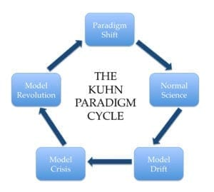
解密神奇的宇宙 Unlocking the Secrets of the Universe
Important term: scientific revolution
(This notion is due to Thomas Samuel Kuhn)
Let‘s all agree that this is how things work...
We need a new model...
Scientists work in the general framework of some paradigms
No, no, no, no! Our model is wrong!
Wait a minute, are we wrong? Let’s adjust our model slightly...
How to overturn a paradigm (you can try it at home!)
Design an experiment to prove Aristotle’s theory about motion of bodies to be wrong.
What do you have to be careful about?
What assumptions will you make?
What and how will you measure?
JinJin STEM Academy

Slide 4
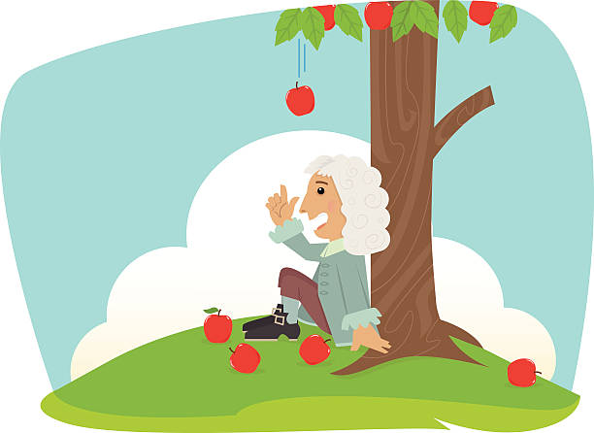
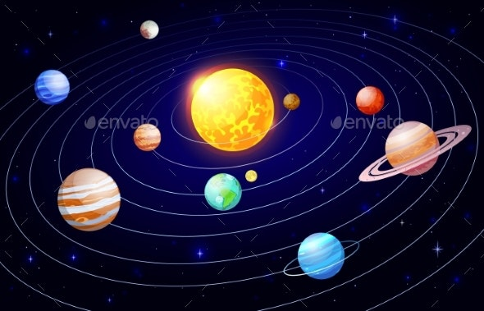
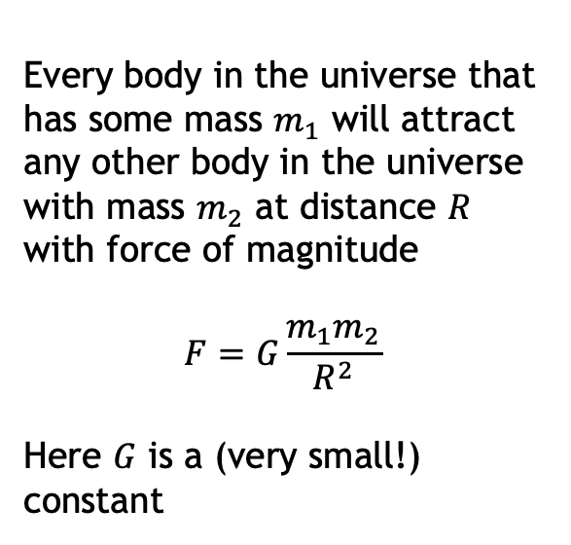
解密神奇的宇宙 Unlocking the Secrets of the Universe
Unification theory
统一理论
A theory that a the same time explains several physical phenomena. It “unifies” （统一）several things that previously were believed to be separate into one framework.
An example of this is gravity: all bodies with mass (including planets, the Moon, stars, black holes, but also you, me and even your cat!) attract each other according to the same math formula.
Conservation laws
守恒律
The ”laws” (general rules) that apply to certain physical quantities.
The most basic conservation laws that you may have already met before are Energy Conservation and Momentum Conservation.
Important term: unification theory
Theories of all sciences – unite!!
A theory that explains several different phenomena using a single framework (框架) is called a “unification theory”
We will learn about several unification theories in this course. The first one is Universal Law of Gravity. Newton’s amazing intuition was that the same force attracts the apple towards Earth’s surface (and causes his headache!) that explains movement of all celestial bodies in the Universe.
Every body in the universe that has some mass $m_{1}$ will attract any other body in the universe with mass $m_{2}$ at distance $R$ with force of magnitude
$$F=G\frac{m_{1}m_{2}}{R^{2}}$$
Here $G$ is a (very small!) constant
Food for thought
Scientists like unification theories.
Gravity is one example. Can you think of other examples from physics, biology, chemistry etc.?
Why do scientists “like to unify things”?
JinJin STEM Academy

Slide 5
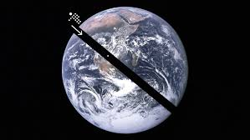
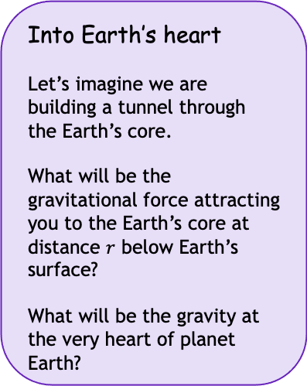

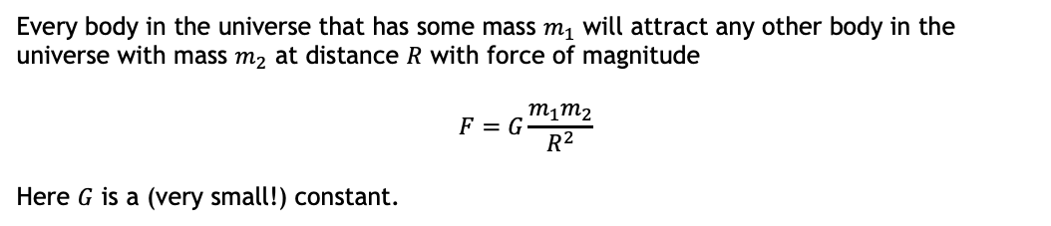
解密神奇的宇宙 Unlocking the Secrets of the Universe
2
Recap on gravity
Every body in the universe that has some mass $m_{1}$ will attract any other body in the universe with mass $m_{2}$ at distance $R$ with force of magnitude
$$F=G\frac{m_{1}m_{2}}{R^{2}}$$
Here $G$ is a (very small!) constant.
Food for thought
What is $R$? How is it measured?
What happens when $R=0$? Is there a paradox here?
Into Earth’s heart
Let’s imagine we are building a tunnel through the Earth’s core.
What will be the gravitational force attracting you to the Earth’s core at distance $r$ below Earth’s surface?
What will be the gravity at the very heart of planet Earth?
Food for thought
Does gravity force every =0?
Are you being attracted by stars in distant galaxies?
Are you attracting the Earth as well?
JinJin STEM Academy

Slide 6
解密神奇的宇宙 Unlocking the Secrets of the Universe
Conservation laws
守恒律
The ”laws” (general rules) that apply to certain physical quantities.
The most basic conservation laws that you may have already met before are Energy Conservation and Momentum Conservation.
Nothing is ever lost in the universe
Conservation laws tell us about certain things that are never “lost” in the universe.
ENERGY 能量
Energy can change its “form” but it never just disappears
Driving a car, we burn fuel to push the car forward: chemical energy is turned into heat and dispersed in the atmosphere, but not “lost”.
Food for thought
We sometimes say that “energy is lost” in certain physical problems. You may have seen this in some physics questions at school before.
What do you think does this mean?
If energy is always conserved, why do we use this term?
MOMENTUM 动量 (mass x velocity)
Momentum in the whole universe also remains conserved
Be careful: when we say “conserved”, we usually assume that we are in a closed, isolated system. If we consider the whole universe as such system, we can say that momentum (or energy) of everything is indeed “conserved” forever.
Application: Escaping planet Earth
Can you use the conservation principle to estimate the speed you need your spaceship to develop to escape Earth’s gravitational field?
JinJin STEM Academy

Slide 7
解密神奇的宇宙 Unlocking the Secrets of the Universe
3
Building rockets!
Rockets burn fuel and eject it with high speed to accelerate. Let’s figure out how this works mathematically, so we can build a rocket and travel to the Moon (and hopefully back!)
Session Summary
Science usually assumes certain things about reality: we call these things “paradigms”. Sometimes, an important paradigm is overturned, which leads to a scientific revolution
Newton’s universal gravity is an example of “unification theory”: a theory that explains many different phenomena as part of a single framework
Conservation laws, such as law of energy conservation and law of momentum conservation, can be used to derive useful results, such as escape velocity and the rocket equation.
We can use these to build rockets that take humans to space, the Moon, Mars, and in the future perhaps also other stellar systems.
Ponder before next class
If classical mechanics does not work for “very small” objects such as atoms or particles, does it mean that it is wrong or in some way incomplete?
Provide 3 examples of a scientific revolution.
When an important paradigm is overturned, the scientific community is often very reluctant to admit this fact. Why do you think this is?
Is it always true that a simple solution is the best solution?
Imagine that there is scientific evidence showing that cats don’t exhibit gravity at all – they just don’t attract anything. What would you think this implies? Would this lead to overturning Newton’s universal theory of gravity?
JinJin STEM Academy

